Slide 1
Why Vulnerabilities are Hard to Eliminate
UT CS361S
Fall 2021
Lecture Notes

Slide 2
Dealing With Control Flow Violations
Make it harder to control a subverted flow
Make taking control of the flow innocuous
Make it harder to get control of the flow

Slide 3
Disrupting Exploitative Operations
Random Stack Gap
ASLR, PIE, etc

Slide 4
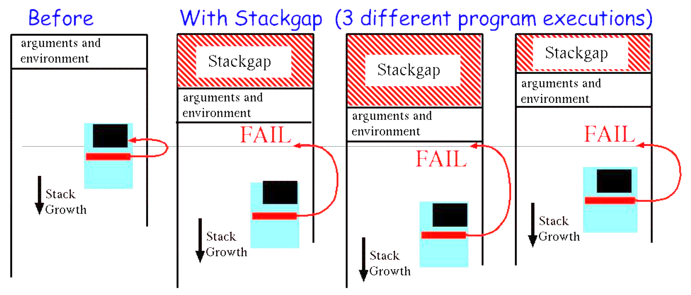
Random Stack Gap

Slide 5
ASLR
Address Space Layout Randomization
Subversion usually needs to know memory layout
General goal: make layout unpredictable

Slide 6
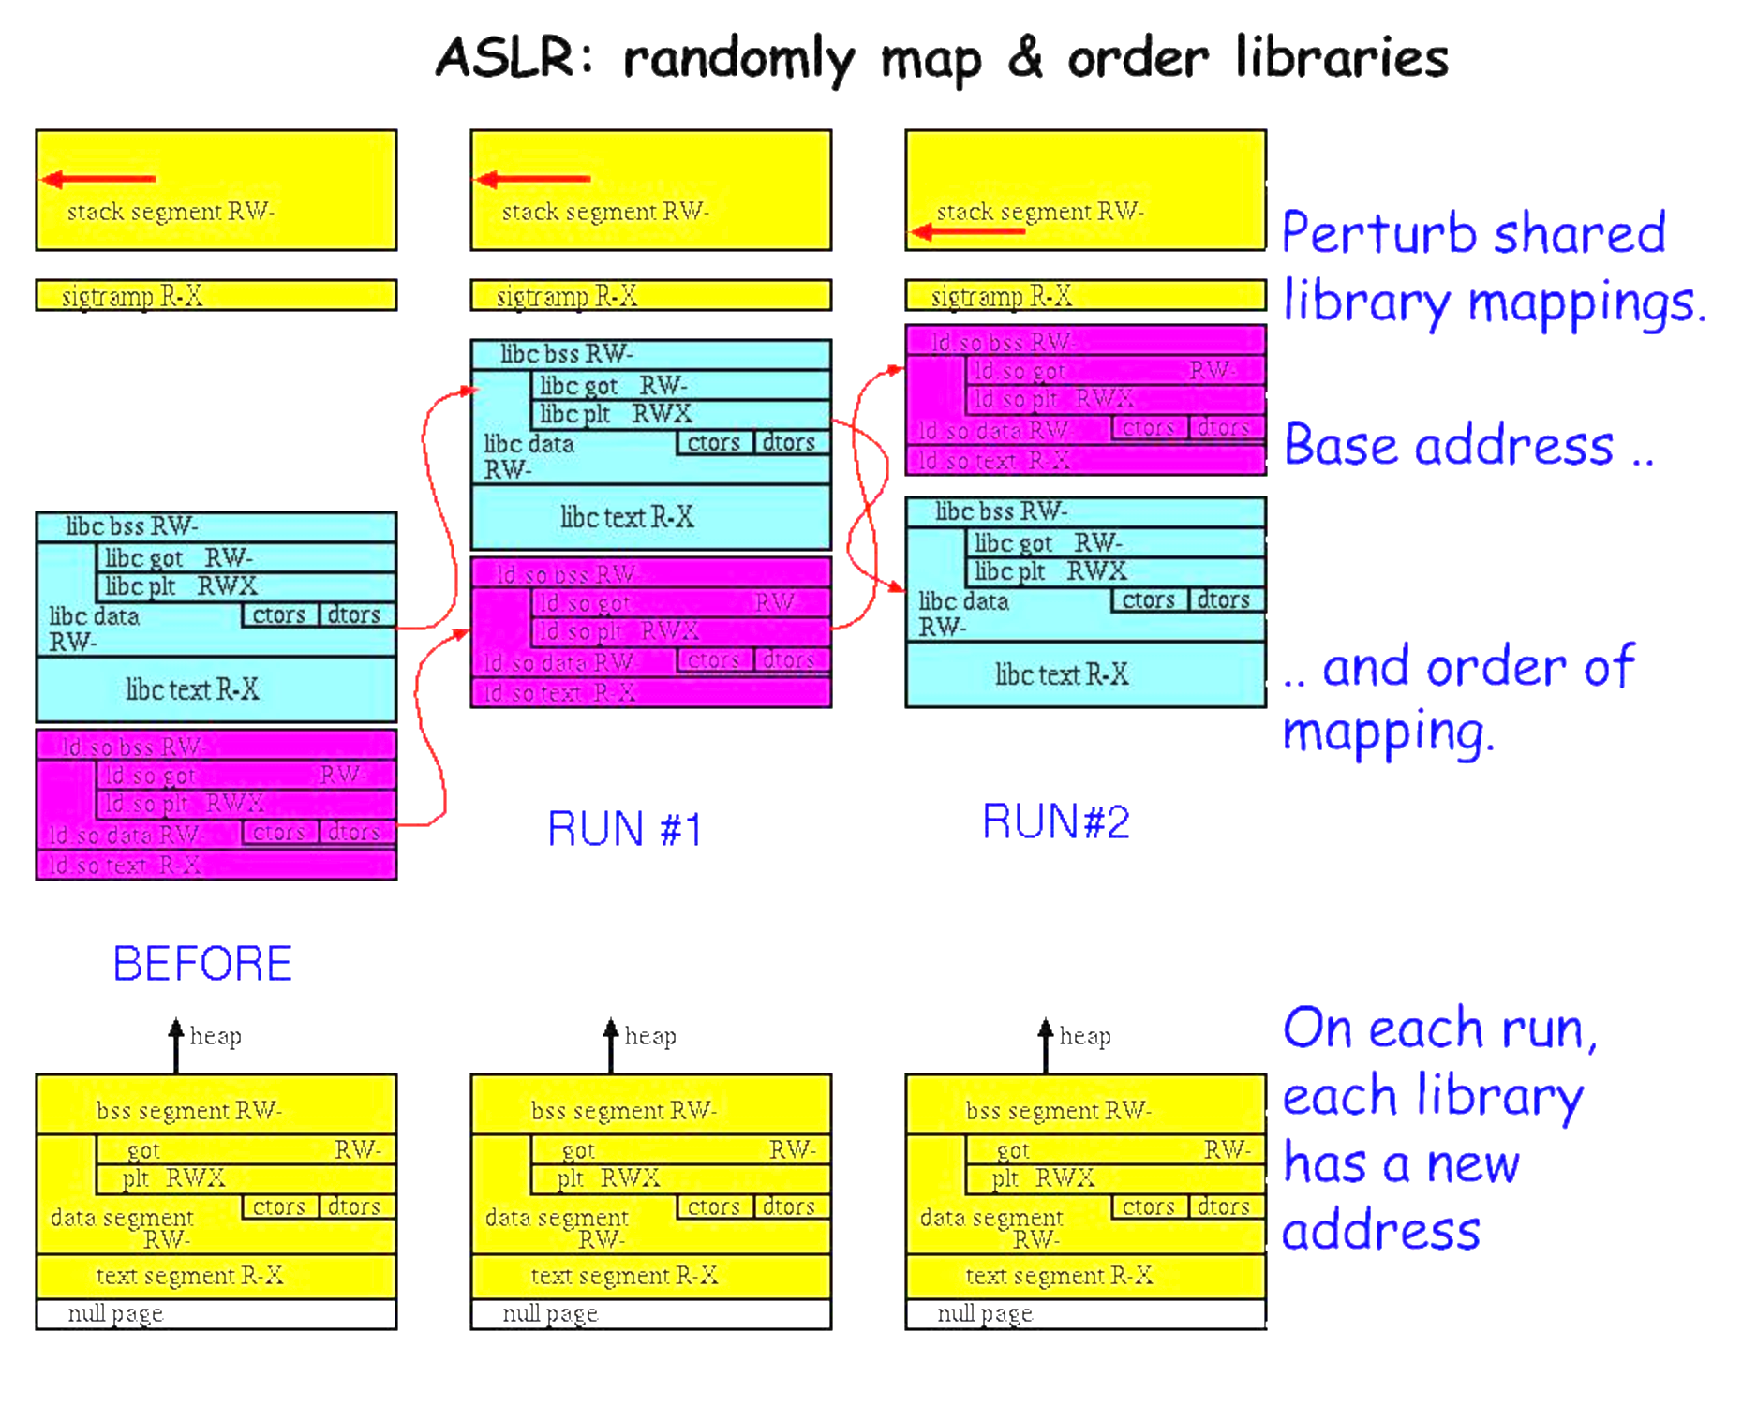
Start With Libraries

Slide 7
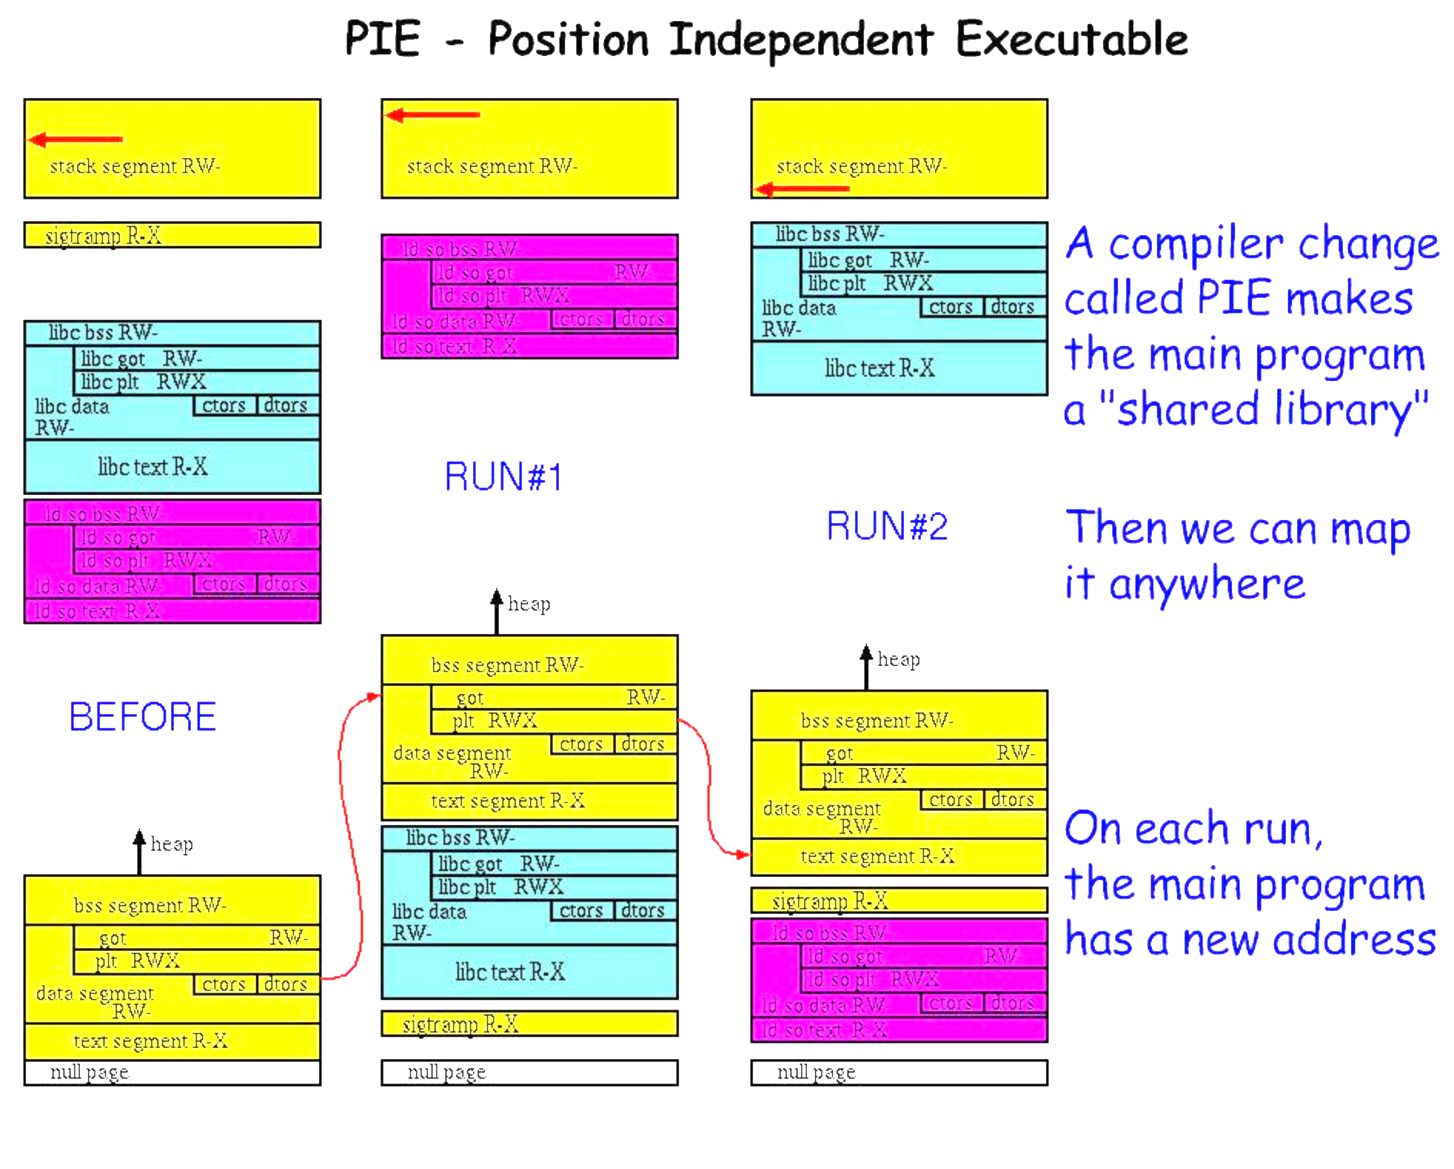
Add Executables

Slide 8
Finally, Dynamic Allocations
mmap
malloc

Slide 9







Limitations of ASLR

Slide 10
Making Violations Less Dangerous
W^X Permissions
rodata

Slide 11
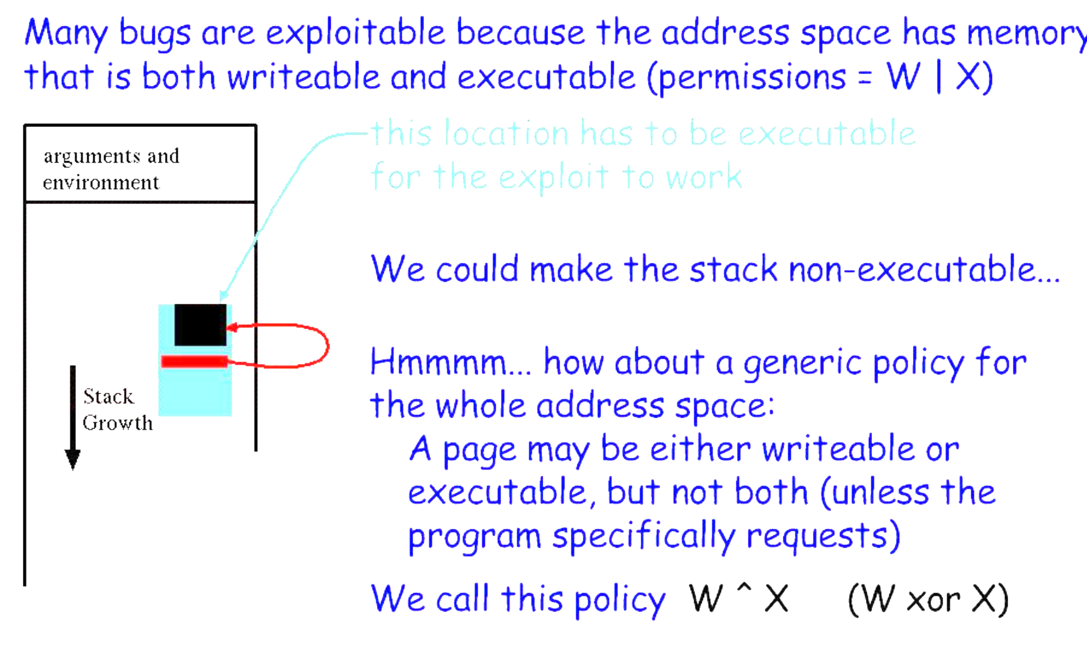
W|x Permissions

Slide 12
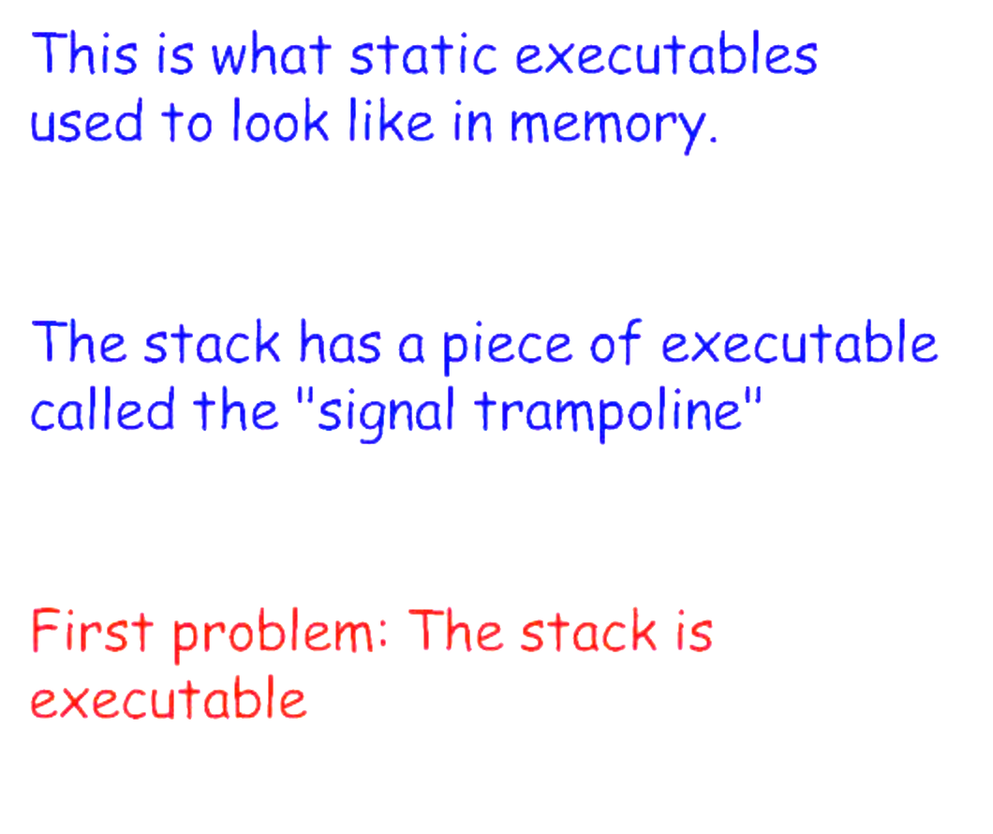
Executable Stacks
What is this?

Slide 13
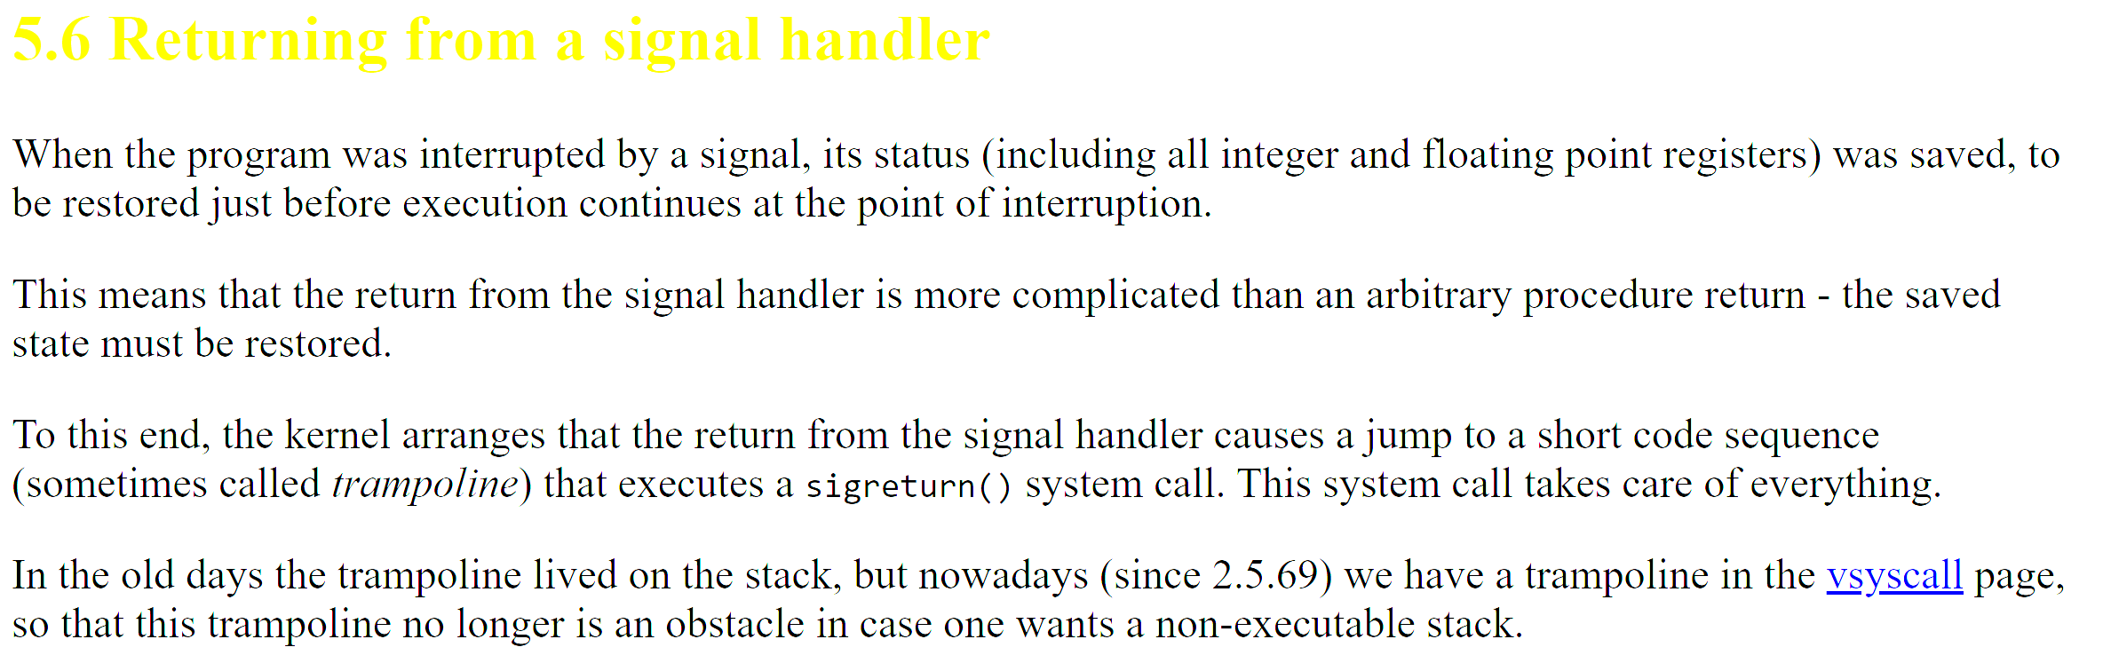
Linux Trampoline?

Slide 14
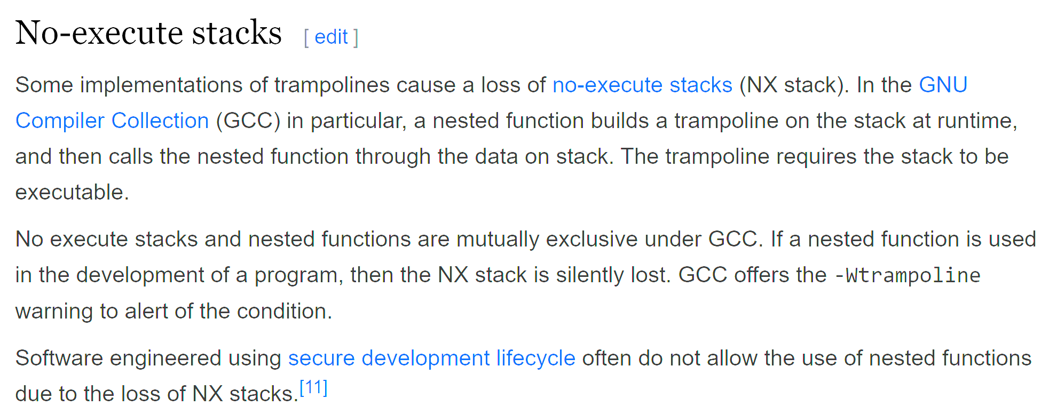

Linux Trampoline!!!

Slide 15
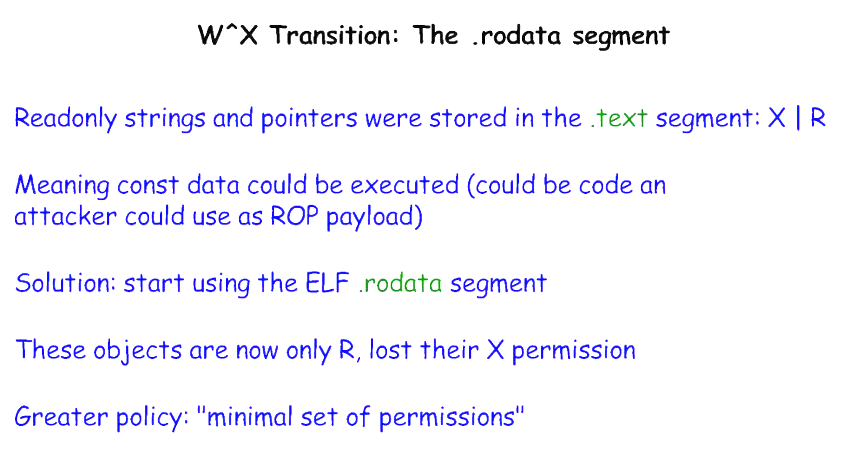
The .rodata Segment

Slide 16
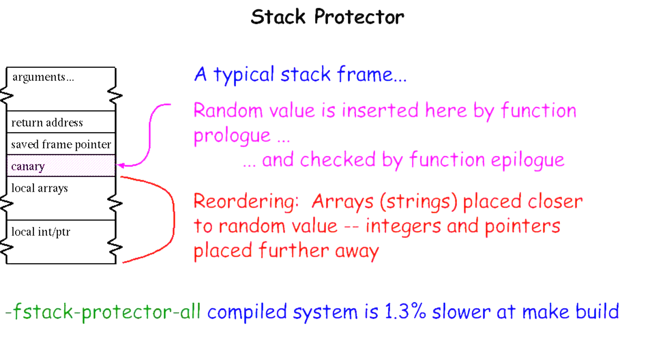
Finally, Blocking Exploits

Slide 17

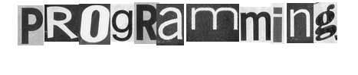
David Brumley
Carnegie Mellon University
Credit: Some slides from Ed Schwartz

Slide 18
Control Flow Hijack: Always control + computation
shellcode (aka payload) | padding | &buf
computation + control
"\x31\xc9\xf7\xe1\x51\x68\x2f\x2f”
"\x73\x68\x68\x2f\x62\x69\x6e\x89”
"\xe3\xb0\x0b\xcd\x80”;
Previously: Executable code as input

Slide 19
Control Flow Hijack: Always control + computation
shellcode (aka payload) | padding | &buf
computation + control
Today: Return Oriented Programming
Execution without injecting code

Slide 20
ROP Overview
Idea: We forge shell code out of existing application logic gadgets
Requirements: vulnerability + gadgets + some unrandomized code (we need to know the addresses of gadgets)
Technically, PREDICTABLE

Slide 21
Motivation: Return-to-libc Attack
ptr to “/bin/sh”
…
argv
argc
return addr
caller’s ebp
“/bin/sh"
argv[1]
buf
ret transfers control to system, which finds arguments on stack
&system
Overwrite return address with address of libc function
setup fake return address and argument(s)
ret will “call” libc function
No injected code!
%ebp
%esp

Slide 22
Question
Randomized!
ptr to “/bin/sh”
…
argv
argc
return addr
caller’s ebp
“/bin/sh"
argv[1]
buf
&system
%ebp
With ASLR, we cannot forge a correct value for ptr since ASLR will randomize addresses.
What can we do?
%esp

Slide 23
Computed “/bin/sh”
Writes
&system
gadgets to compute ptr to “/bin/sh”
Idea!
Get a copy of ESP to calculate address of “/bin/sh” on randomized stack.
This works because ASLR only protects against knowing absolute addresses, while we will find it’s relative address.
…
argv
argc
return addr
caller’s ebp
buf “/bin/sh”
argv[1]
buf
Notes:
Useful, for example, to get a copy of ESP. If we know relative offset of ptr to esp, we can know use that relative offset knowledge to locate a pointer.
This overcomes ASLR because ASLR only protects against knowing absolute addresses.

Slide 24
Return Chaining
Suppose we want to call 2 functions in our exploit: foo(arg1, arg2) bar(arg3, arg4)
Stack unwinds up
First function returns into code to advance stack pointer
e.g., pop; pop; ret
arg4
arg3
&(pop-pop-ret)
bar
arg2
arg1
&(pop-pop-ret)
foo
What does this do?
Overwritten ret addr
Notes:
Note that when foo runs, foo thinks &pop-pop-ret as the saved return address. It accesses arg1 and arg2.
When foo returns, it executes &pop-pop-ret to remove the arguments to foo, and then executes bar.

Slide 25
Return Chaining
When foo is executing, &pop-pop-ret is at the saved EIP slot.
When foo returns, it executes pop-pop-ret to clear up arg1 (pop), arg2 (pop), and transfer control to bar (ret)
arg4
arg3
&(pop-pop-ret)
bar
arg2
arg1
&(pop-pop-ret)
foo
Notes:
Note that when foo runs, foo thinks &pop-pop-ret as the saved return address. It accesses arg1 and arg2.
When foo returns, it executes &pop-pop-ret to remove the arguments to foo, and then executes bar.

Slide 26
There are many semantically equivalent ways to achieve the same net shellcode effect
Let’s practice thinking in gadgets

Slide 27
An example operation
...
v₂
...
v₁
Mem[v2] = v1
Desired Logic
esp
Stack
a₁: mov eax, [esp] ; eax has v1
a₂: mov ebx, [esp+8] ; ebx has v2
a₃: mov [ebx], eax ; Mem[v2] = eax
Implementation 1

Slide 28
implementing with gadgets
Suppose a₅ and a₃ on stack
a₅
v₂
a₃
v₁
Mem[v2] = v1
Desired Logic
esp
Stack
a₁: pop eax
a₂: ret
a₃: pop ebx
a₄: ret
a₅: mov [ebx], eax
eax
ebx
eip
v₁
a₁
Implementation 2

Slide 29
implementing with gadgets
a₅
v₂
a₃
v₁
Mem[v2] = v1
Desired Logic
esp
Stack
a₁: pop eax
a₂: ret
a₃: pop ebx
a₄: ret
a₅: mov [ebx], eax
eax
ebx
eip
v₁
a₁
a₃
Implementation 2

Slide 30
implementing with gadgets
a₅
v₂
a₃
v₁
Mem[v2] = v1
esp
Desired Logic
Stack
a₁: pop eax
a₂: ret
a₃: pop ebx
a₄: ret
a₅: mov [ebx], eax
eax
ebx
eip
v₁
v₂
a₃
Implementation 2

Slide 31
implementing with gadgets
a₅
v₂
a₃
v₁
esp
Mem[v2] = v1
Desired Logic
Stack
a₁: pop eax;
a₂: ret
a₃: pop ebx;
a₄: ret
a₅: mov [ebx], eax
eax
ebx
eip
v₁
v₂
a₄
a₅
Implementation 2

Slide 32
implementing with gadgets
esp
a₅
v₂
a₃
v₁
Mem[v2] = v1
Desired Logic
Stack
a₁: pop eax;
a₂: ret
a₃: pop ebx;
a₄: ret
a₅: mov [ebx], eax
Gadget 1
eax
ebx
eip
v₁
v₂
Gadget 2
a₅
Implementation 2
Notes:
Note the gadgets can be in separate locations...gadget 1 does not have to be contiguous with gadget 2.

Slide 33
Equivalence
a₃
v₂
a₂
v₁
Mem[v2] = v1
Desired Logic
semantically equivalent
esp
Stack
“Gadgets”
a₁: mov eax, [esp]
a₂: mov ebx, [esp+8]
a₃: mov [ebx], eax
a₁: pop eax; ret
a₂: pop ebx; ret
a₃: mov [ebx], eax
Implementation 1
Implementation 2

Slide 34
Return-Oriented Programming (ROP)
…
argv
argc
return addr
caller’s ebp
buf (64 bytes)
argv[1]
buf
Mem[v2] = v1
Desired Shellcode
%ebp
Find needed instruction gadgets at addresses a₁, a₂, and a₃ in existing code
Overwrite stack to execute a₁, a₂, and then a₃
%esp

Slide 35
Return-Oriented Programming (ROP)
a₃
v₂
a₂
v₁
a₁
…
argv
argc
return addr
caller’s ebp
buf (64 bytes)
argv[1]
buf
Mem[v2] = v1
Desired Shellcode
%ebp
a₁: pop eax; ret
a₂: pop ebx; ret
a₃: mov [ebx], eax
Desired store executed!
%esp

Slide 36
Equivalence
a₃
v₂
a₂
v₁
Mem[v2] = v1
Desired Logic
Address independent!
Stack
a₁: pop eax; ret
...
a₃: mov [ebx], eax ...
a₂: pop ebx; ret
a₁: pop eax; ret
a₂: pop ebx; ret
a₃: mov [ebx], eax
Implementation 2

Slide 37
Gadgets
A gadget is a set of instructions for carrying out a semantic action
mov, add, etc.
Gadgets typically have a number of instructions
One instruction = native instruction set
More instructions = synthesize <- ROP
Gadgets in ROP generally (but not always) end in return

Slide 38
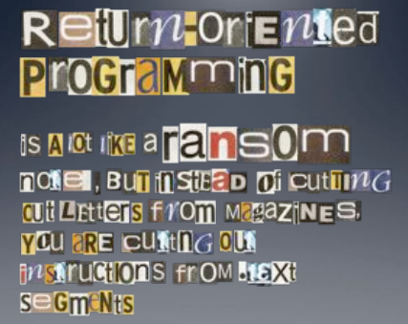
Image by Dino Dai Zovi

Slide 39
RO(P?) Programming
Disassemble code
Identify useful code sequences as gadgets
Assemble gadgets into desired shellcode

Slide 40
Attacker Oriented Programming?
Behavior isn’t a program
We should be able to perfectly detect bad behavior, right?

Slide 41
“Weird Machines”
“Weird machines, exploitability, and provable unexploitability”
Written by Thomas Dullien
Explains that users interacting with a program is a program

Slide 42
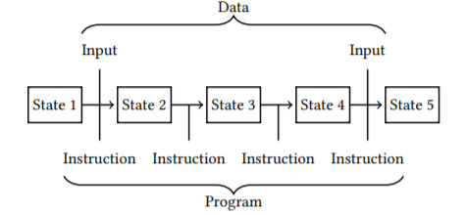
What is a Program?
*From Dullien’s Paper

Slide 43
State Machine View
View a “Program” as a state machine
Program starts in state S_0
Based on instruction, advances to state S_i

Slide 44
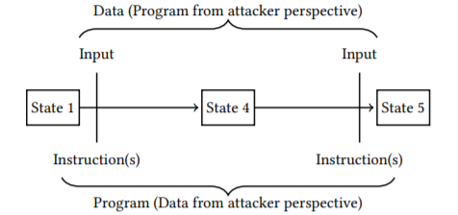
States and User Interactions
Program is in some State. Call it S_0
User interacts with the program
Program advances to state S_1

Slide 45
What is a “User”?
Do we literally mean a flesh-and-blood human?
Really, “user” is just whatever provides the input
This can, of course, just be another process
Thus, two processes interacting IS A PROGRAM
Therefore, determining if “behavior” is good is undecidable

Slide 46
One More Big Problem
Decidability is a fundamental, unsolvable problem
Another big problem is Supply Chain

Slide 47
1984: Thompson’s Reflections
“Reflections on Trusting Trust” by Ken Thompson, 1984
Demonstrated creating an evil compiler
Would compile a login program with a backdoor
BUT! ALSO COMPILED COMPILERS WITH THIS LOGIC!
“Clean” compiler source code compiled by an evil compiler is evil!
Proved that a “source code review” can’t catch all evil

